Slide 1
MobaXterm
Jens Mueller, PhD
HPC Services, Miami University

Slide 2
MobaXterm
MobaXterm is one example for an integrated terminal/X11 client for Win platform
Others, including commercial ones, exist
Can be configures for SSH keypairs
Has integrated file transfer (scp)
X11 “forwarding” maybe slow
Sessions are not reconnectable
Good for quick- or backup gateway to host (cluster)

Slide 3
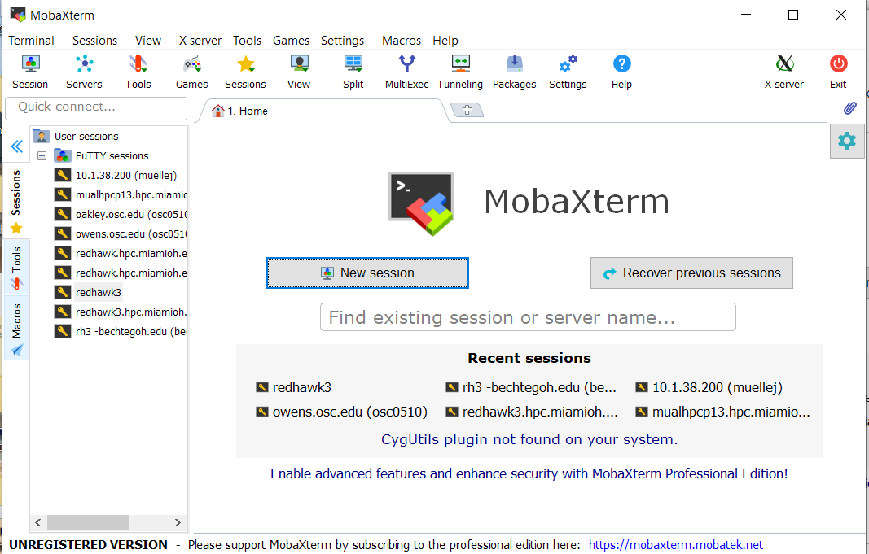
MobaXterm
Get it from https://mobaxterm.mobatek.net/

Slide 4
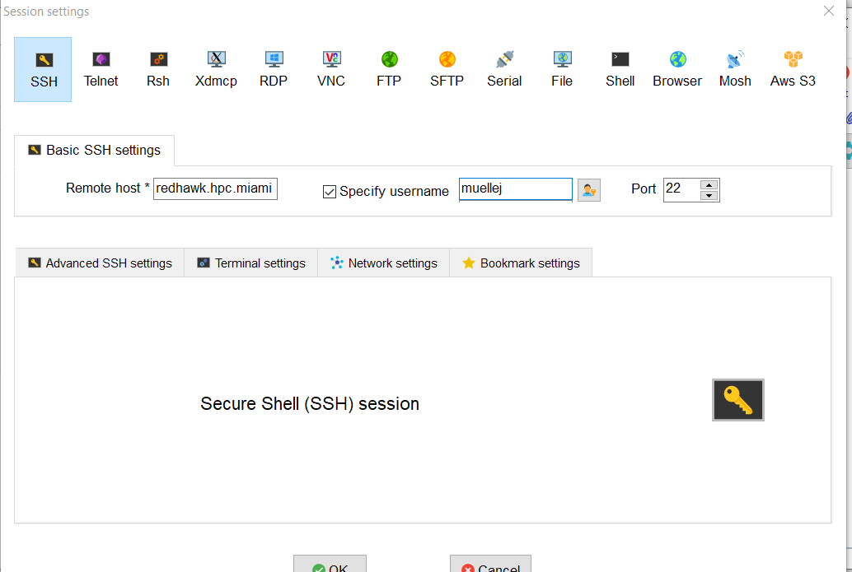
MobaXterm

Slide 5
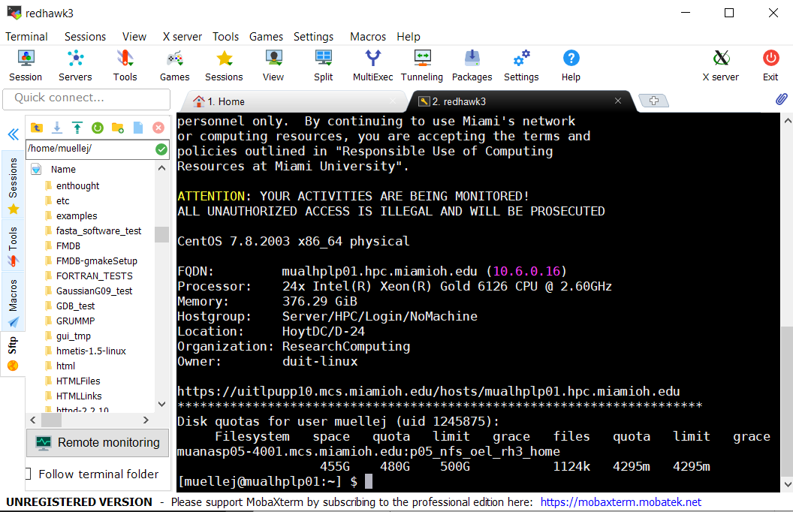
MobaXterm

